Slide 1

Project Title :
Bike Sharing Demand Prediction
AICTE STU ID : STU6a666ea373b7c1785097891
Student Name : Sunil Revanasiddappa Rathod
Gmail : sunilrrathod830@gmail.com
Demo Link :https://github.com/SunilRRathod830/Bike-Sharing-Demand-Prediction.git

Slide 2

PROBLEM STATEMENT
Bike-sharing demand changes throughout the day and can vary based on time, season, holidays, and system operating conditions. Accurately understanding and predicting this demand can help improve bike availability and operational planning.
This project aims to analyze historical Seoul bike-sharing data and develop a machine-learning model to predict the number of rented bikes (Rented Bike Count) using relevant temporal and categorical features

Slide 3
Project Objectives
Analyze the Seoul Bike Sharing Demand dataset.
Understand bike-rental demand patterns across different time periods.
Identify important factors associated with bike-sharing demand.
Perform data cleaning, preprocessing, and exploratory data analysis.
Create meaningful visualizations to understand demand patterns.
Build a Linear Regression model to predict rented bike count.
Evaluate model performance using MAE, RMSE, and R² Score.
Save and verify the trained machine-learning model.

Slide 4
Dataset Description
Dataset: Seoul Bike Sharing Demand
Dataset Size: 8,760 hourly records
Original Features: 14 columns
Target Variable: Rented Bike Count
Time Information: Date, Hour, Year, Month, Day, DayOfWeek
Weather Information: Temperature, Humidity, Wind Speed, Visibility
Additional Weather Factors: Dew Point Temperature, Solar Radiation, Rainfall, Snowfall
Categorical Information: Seasons, Holiday, Functioning Day
Main Point
The dataset contains hourly bike-rental demand along with temporal, weather, seasonal, holiday, and operating-condition information.

Slide 5

Technology Used
Python — Core programming language.
Pandas — Data loading, cleaning, and manipulation.
NumPy — Numerical operations and calculations.
Matplotlib — Data visualization.
Seaborn — Statistical visualization and EDA.
Scikit-learn — Preprocessing, Linear Regression, and model evaluation.
Joblib — Saving and reloading the trained model.
Jupyter Notebook / VS Code — Project development and execution.
Main Point
Python-based data analysis and machine-learning libraries are used to build the complete bike-demand prediction workflow.

Slide 6
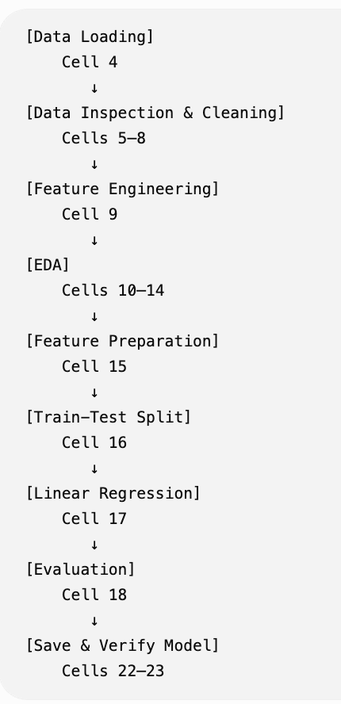
RESULTS
Demo Link :https://github.com/SunilRRathod830/Bike-Sharing-Demand-Prediction.git

Slide 7
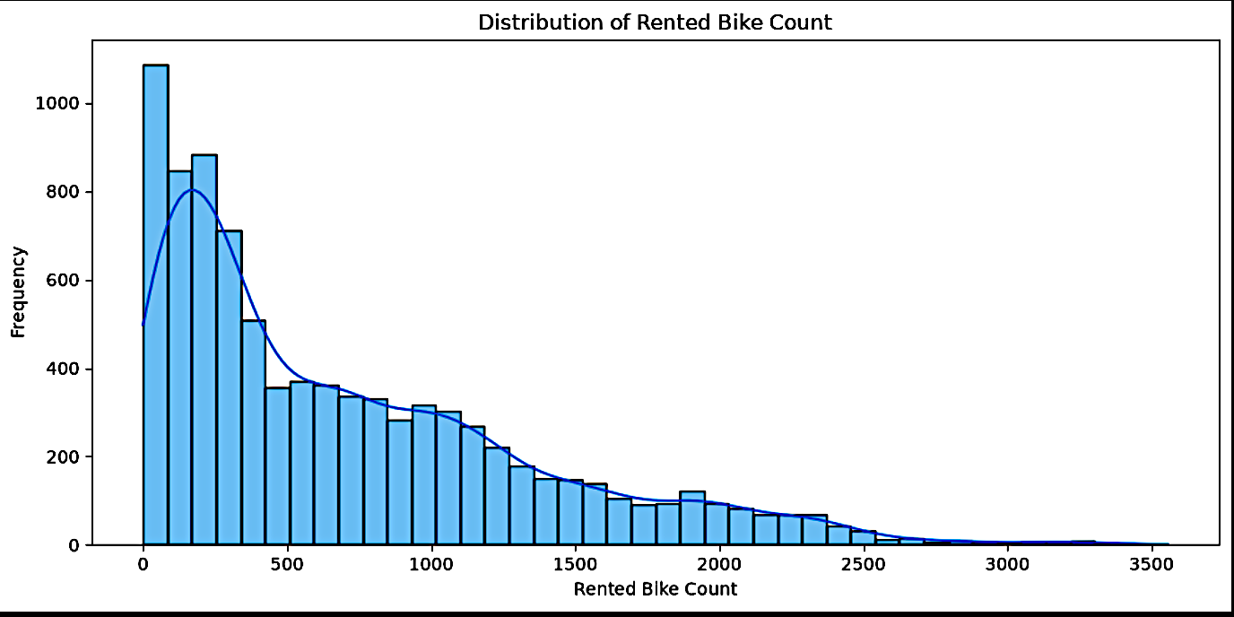
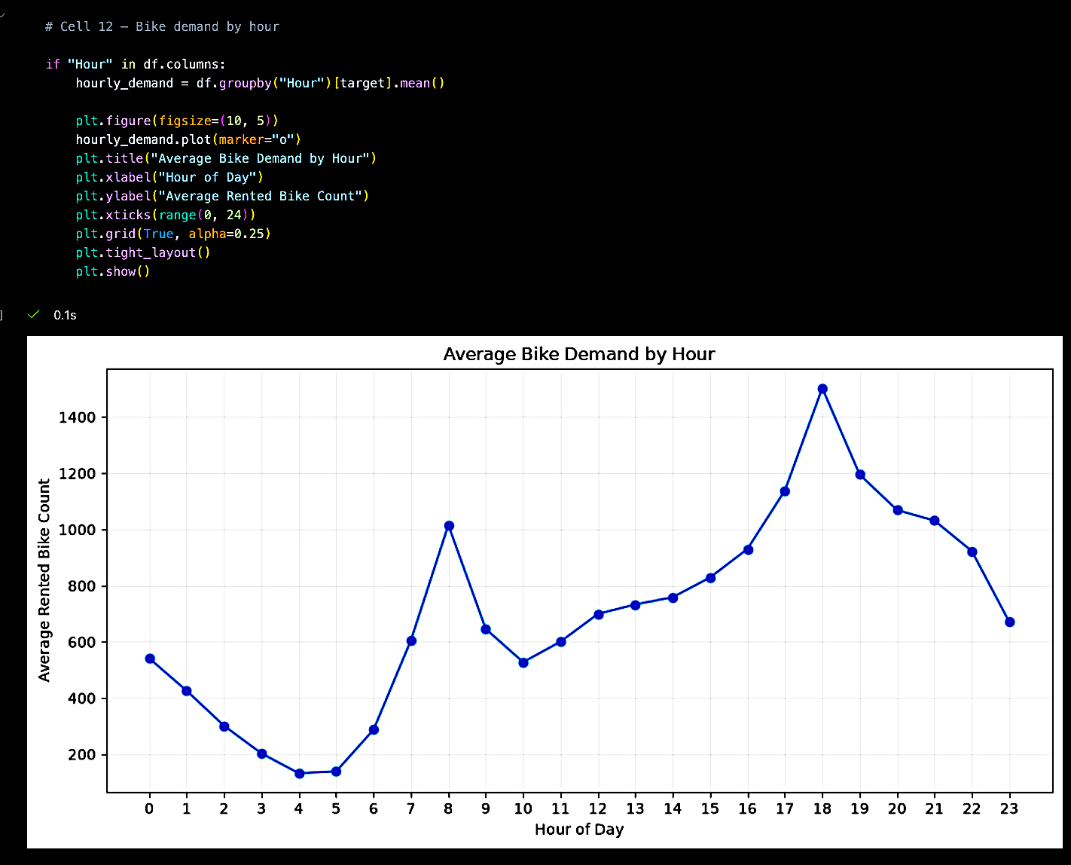
RESULTS
Exploratory Data Analysis
Target Distribution — Analyze the distribution of rented bike demand.
Hourly Demand — Identify variations in demand across different hours.
Seasonal Analysis — Compare bike demand across different seasons.
Correlation Analysis — Examine relationships between numerical variables.
Visualization — Use charts to identify important demand patterns.
Demo Link :https://github.com/SunilRRathod830/Bike-Sharing-Demand-Prediction.git

Slide 8
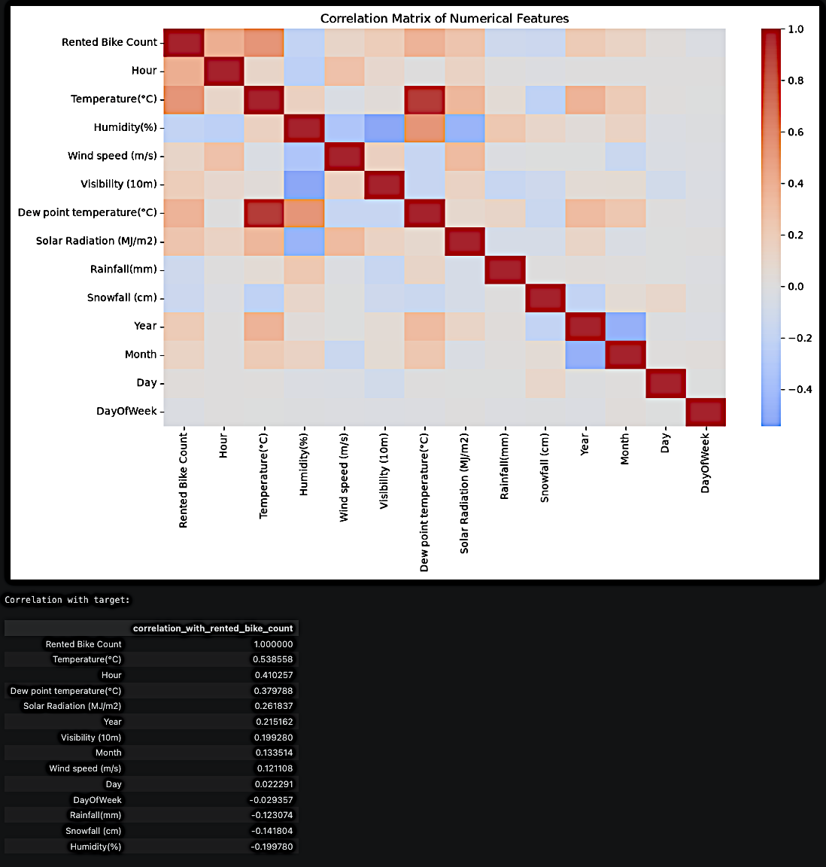
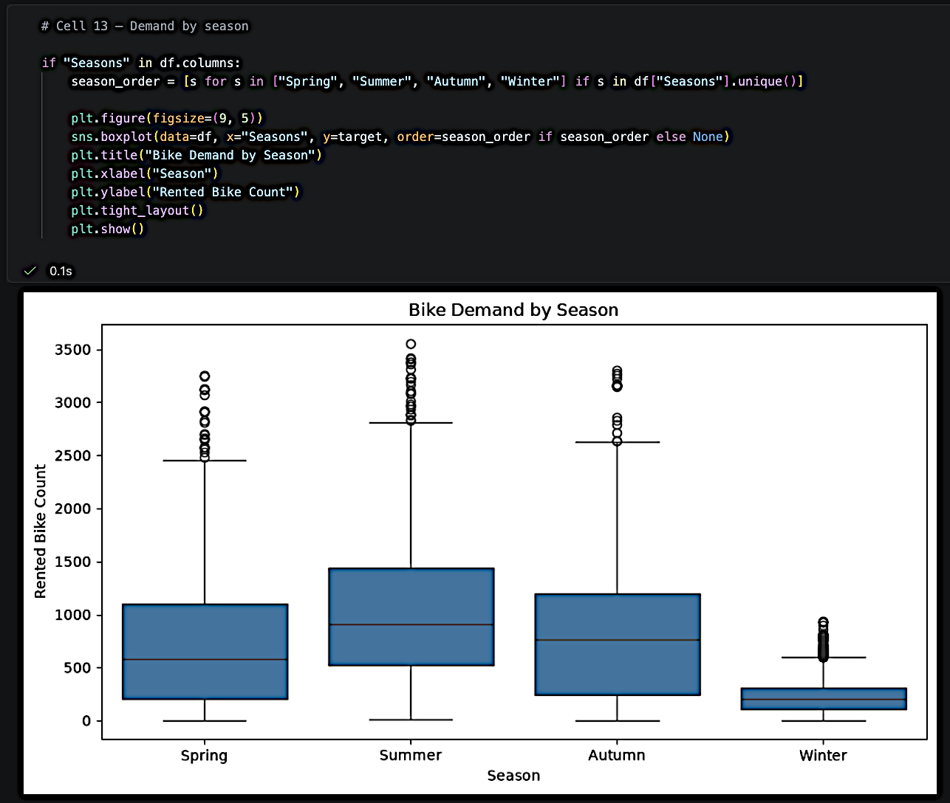
RESULTS

Slide 9
Correlation Analysis
Key Finding
Key Finding: The correlation heatmap shows the strength and direction of relationships between numerical variables and Rented Bike Count.
CORRELATION ANALYSIS
↓
┌─────────────────────┐
│ │
│ CORRELATION │
│ HEATMAP │
│ │
│ Cell 14 │
│ │
└─────────────────────┘
Key Finding:
The correlation heatmap shows the strength and direction
of relationships between numerical variables and
Rented Bike Count.
Source: Notebook Cell 14

Slide 10
Final Model Features
Dataset Split
Training Samples: 7,008
Testing Samples: 1,752
Total Samples: 8,760
The model uses 8 final features:
Hour — Hour of the day
Year — Year of the observation
Month — Month of the year
Day — Day of the month
DayOfWeek — Day of the week
Seasons — Seasonal information
Holiday — Holiday / non-holiday information
Functioning Day — Whether the bike-sharing system was operating

Slide 11
Machine Learning Model
Random Forest Regression
Model: Random Forest Regressor
Number of Trees: 200
Random State: 42
Training Samples: 7,008
Testing Samples: 1,752
Input: 8 selected features
Output: Predicted Rented Bike Count

Slide 12
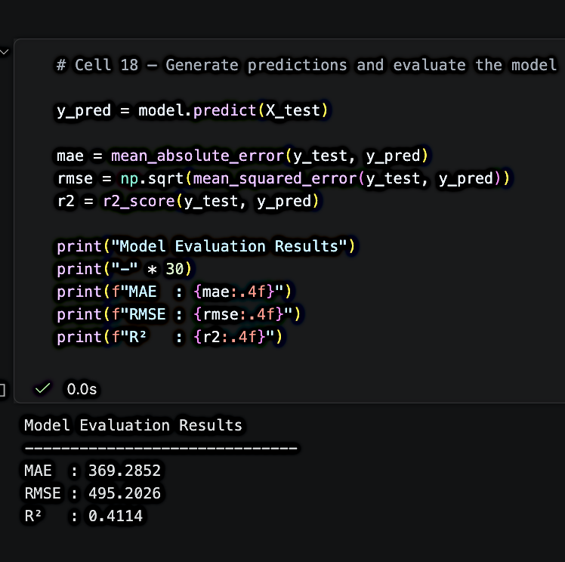
Model Evaluation
Model Performance
Evaluation Metrics:
MAE: 369.2852
RMSE: 495.2026
R² Score: 0.4114
What These Metrics Mean
MAE (Mean Absolute Error): The model's predictions differ from the actual bike demand by approximately 369 bikes on average.
RMSE (Root Mean Squared Error): The average prediction error is approximately 495 bikes, with larger errors having more influence.
R² Score: The model explains approximately 41.14% of the variation in rented bike demand.

Slide 13
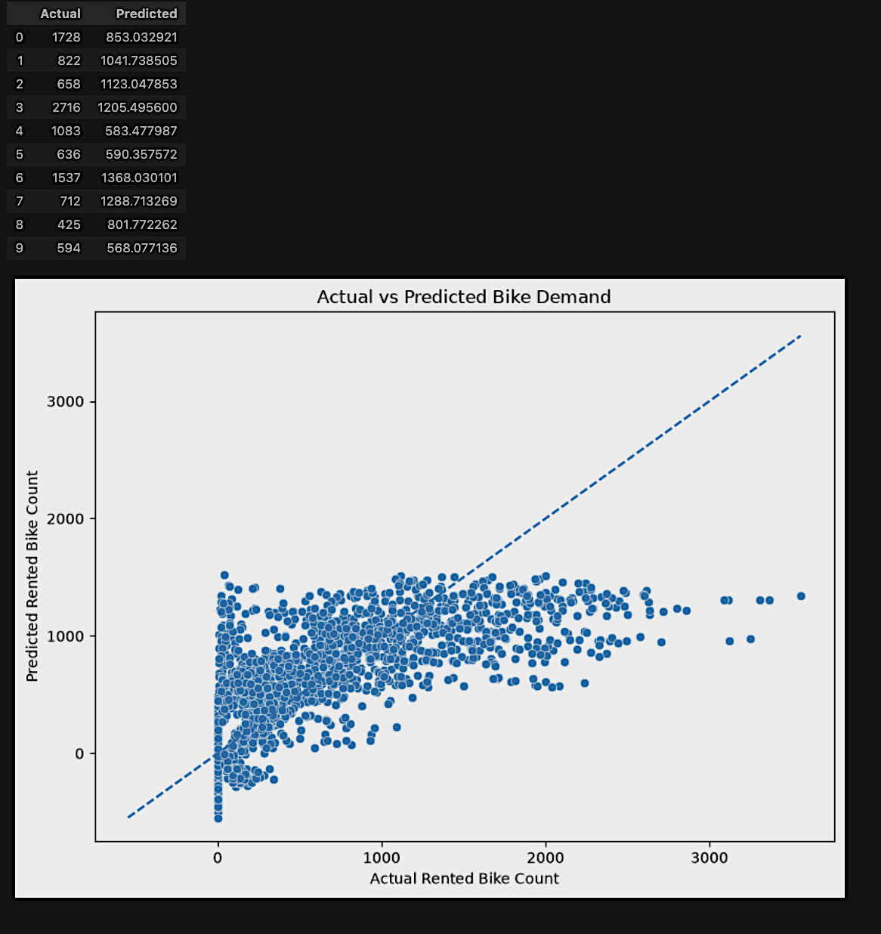
Prediction Analysis
Scatter Plot: Actual vs Predicted
X-axis: Actual Rented Bike Count
Y-axis: Predicted Rented Bike Count
Add a reference diagonal line (y = x) if your notebook generates one.
Points closer to the diagonal line indicate more accurate predictions.
Key Observation
The scatter plot shows the relationship between actual and predicted bike demand and helps identify where the model underpredicts or overpredicts demand.

Slide 14
Thank you
.
.

